Slide 1
Computing and Information Technology Three Year Plan: 2012-2015
Mission: Advance UB's mission of excellence in research, teaching and service through the innovative and effective use of information technology.

Slide 2
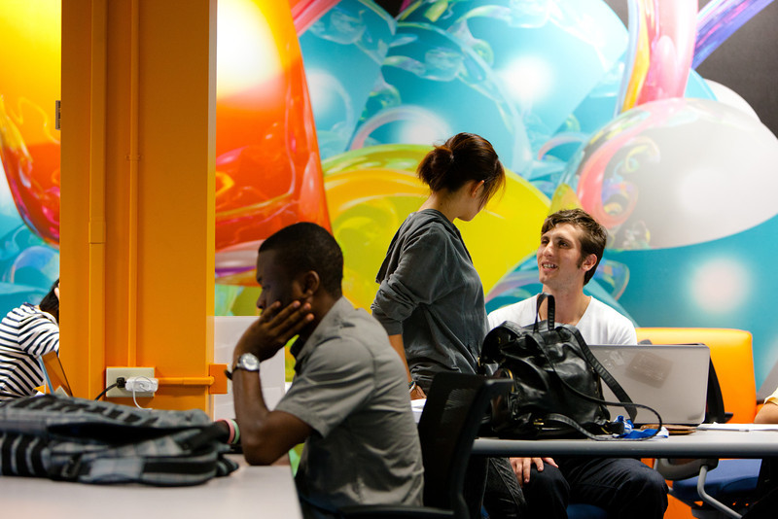
Outline
IT at UB
CIT – Past 5 Years
CIT – Today
CIT – Future
2012/13 Projects & Priorities
Research Computing
Summary

Slide 3
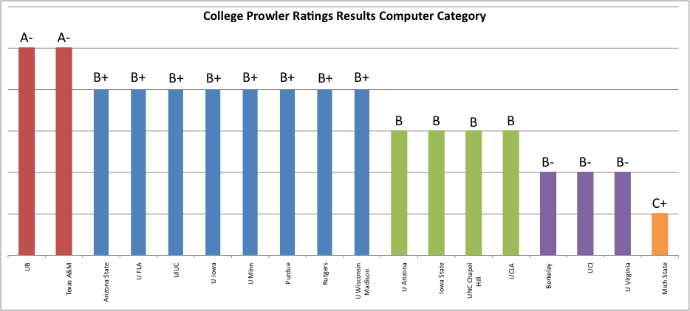
Satisfied Students
UB’s IT services rank highly on the College Prowler website (www.collegeprowler.com)
UB

Slide 4
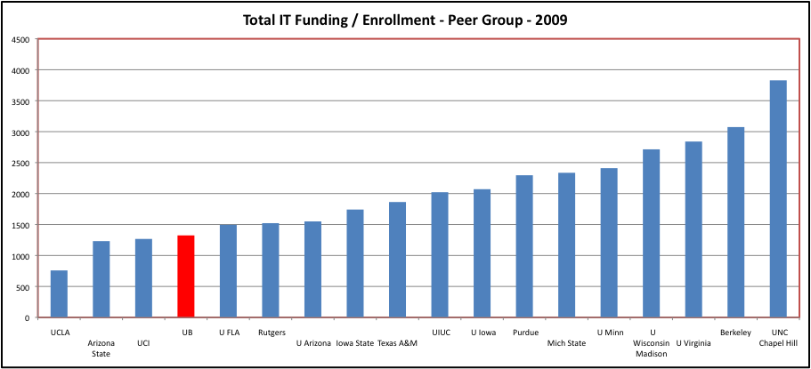
Efficient Operation
Central IT funding per student compared to peers

Slide 5
CIT - The Past 5 Years
Reduction of $5M in budget and 10 FTE
Ave annual increases of 9% in software & hardware maint costs
New and expanded technology offerings and services
HUB
UBCMS Web Content Management System Developed
Consolidation Across Campus
Virtualization (est savings $1M)
VOIP (est $3.5M cost avoidance across campus)
Departmental server room consolidation (est savings >> $200K)
Email consolidation (est savings $80K)
File Services (est savings $180K)
Note: All these consolidations resulted in increased costs to CIT
Networking (10 gE backbone, campus wireless coverage)
$10M Research Computing Upgrade (external funds)
IT Design and support for 7 new buildings
Cybrary
Expanded hours of operation

Slide 6
Examples of Increasing IT Infrastructure Costs
Wireless Minimal Coverage and Subsequent Expansion
Six to seven year program to provide minimal wireless coverage (@$700K per year)
On going maintenance costs were not budgeted
~345 Access Point (AP) installations per year for past 7 years (~2600 AP’s)
Average annual expenditure of $700K translates to $2,000/AP
Full capacity build out requires ~4680 AP’s.
Average technology lifespan is 10 years with a replacement cost ~$1,750/AP
At 2600 AP’s we will need to replace 260 AP’s per year at a cost of $455K/year.
At full build out we will need to replace 468 AP’s per year at a maintenance cost of $819k/year.
(This assumes additional funds are provided over the next 3 – 5 years to allow us to reach full capacity in AP’s).
Conclusion: What started out as a 6 year plan for minimal wireless coverage across UB with an annual commitment of $700K translates to a more than $800K annual maintenance cost, exclusive of further expansion costs.

Slide 7
Core Operations: What We Do Everyday
HUB
UBlearns
Student Software
Data Network
Wireless
Storage
Data Center
Email
Emergency Systems
Public Labs
Infosource /SIRI
Web Content Management
Portal MyUB
Sponsored Program Support
VOIP
Virtual Computing
Classroom Services
Campus Business Operations
RESNET
SUNY Interfaces
Research Computing Support

Slide 8
CIT - Today: Well Positioned
Virtual Computing Lab
Compute anywhere, anytime
Mobile Computing Strategy Launched
Wireless Coverage for Entire Campus
UBCMS System Ready for Campus Wide Deployment
Improved Campus Computing Labs
Expanded Cell Phone Coverage Plan Underway (DAS) – no cost to UB ($1-2M investment)
Revamped Help Desk Services
Embracing Cloud Services
Student email, IRB Net, Conflict of Interest, UB Jobs, AdvisorTrac, TutorTrac, Coeus….
Akamai and Google provide on-campus content caching services - no cost to UB ($17K/year savings)
Notes:
UBIT forged partnerships with Akamai and Google to provide on-campus content caching services. The initiative increased content delivery speeds for users and reduced campus bandwidth utilization by close to 300 Mb/s at peak. This has increased our bandwidth efficiency and translates to $17k/year savings.
UB Has entered into a partnership with Verizon Wireless to deploy a Distributed Antenna System on the campus to improve in-building cellular coverage. Verizon has constructed the system at no cost to the University and has designed it to accommodate other carriers. The first wave of deployment covers Ellicott and Governors and subsequent phases are being planned for rollout in other buildings.

Slide 9
Guiding Principles – Three Year Plan
Support the mission of the University
Invest in our people
Professional development
Be proactive and not reactive
Cybrary, Mobile Computing, Business Systems Trans.
Do things smarter
Continue to innovate – be an academic leader in IT
Virtual Computing Lab, Elec Doc Management, CCR
Minimize FTE’s dedicated to “keeping the lights on” and deferred maintenance (currently at 85%)

Slide 10
CIT – Tomorrow: Looking to the Future
Business Systems Transformation
SUNY HR
Facilities Transformation (started)
Expand Wireless Network
Electronic Document Management
Virtual Desktop Environment
HUB Mobile
Digital Classroom Technology
Supporting On-line learning
Campus Reporting
Smart Buildings Pilot Project (Energy Conservation)
Research Computing – Big Data Analytics
Building a Downtown Campus Network

Slide 11
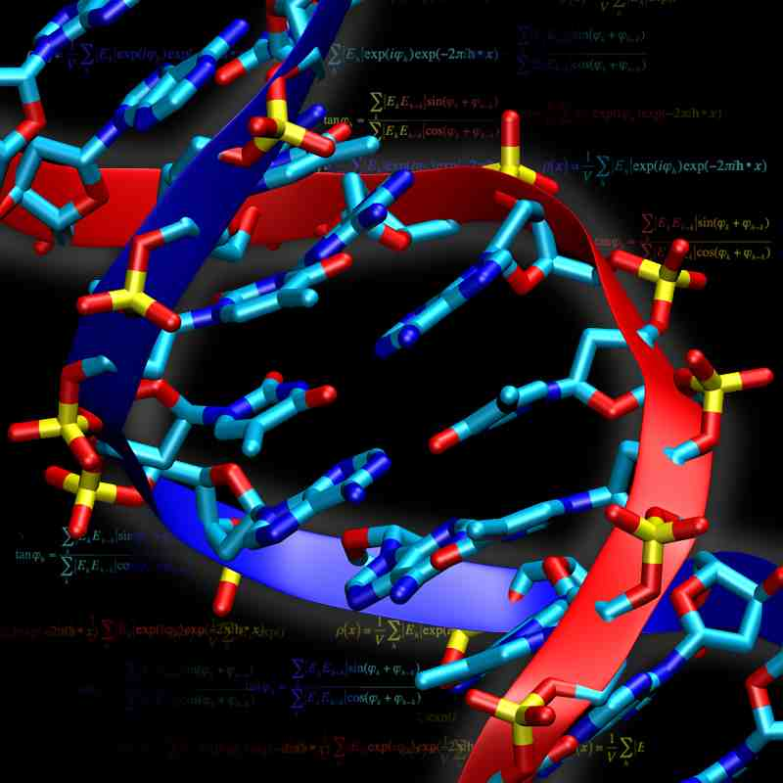
Research Computing Support
CCR Overview for 2012
Utilization
454 users (147 faculty)
2M jobs run
2.2M CPU days delivered
600 TB of high performance storage
Grant Proposals
95 proposals totaling $217M submitted (CCR included on SPA approval form)
Current CCR Grant Funding
Total value of current CCR grant funding $11.5M (CCR staff serve as PI or coPI)
$500K+ overhead returned to university in 2012
$100K salary recovery returned to university in 2012 (20% tax)

Slide 12
Summary
Projected funding model allows us to maintain current service levels for the next few years (assuming capital money continues)
Policy for funding new strategic campus IT initiatives needs to be addressed
Stable funding model needed for:
Increases in the ongoing cost of supporting current systems and services. Ongoing support costs of new campus IT initiatives
IT capital allocation is not adequate to support on-going campus core infrastructure needs (ex. datacenter electrical and HVAC systems)
CCR
Further engage campus community to help determine priorities (ETAG, ESAC)
Hub governance
Mobile governance
Workstation Standards Committee
Classroom Committee
DCTAC (Digital Communication Technology Advisory Committee)

